Slide 1
Baye’s Theorem Example Questions
Binomial Probability Distribution

Slide 2
Binomial Probability Distribution
The Binomial Probability Distribution is a discrete probability distribution used to model scenarios where there are only two possible outcomes in each trial. These outcomes are typically referred to as "success" and "failure." It is widely used in experiments or situations where the following conditions hold:

Slide 3
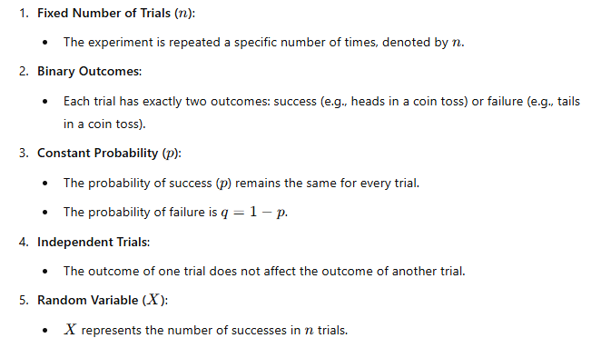
Key Characteristics

Slide 4
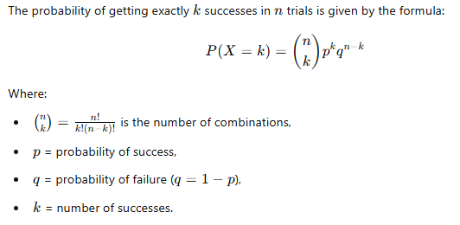
Probability Formula

Slide 5
Real-Life Analogy
Imagine you're flipping a coin. A coin flip has two possible outcomes: heads (success) and tails (failure). Let's say you flip the coin n=5 times and are interested in how many times you get heads. If the coin is fair (p=0.5), the number of heads in 5 flips can be modeled using a binomial distribution.

Slide 6
Example 1: Flipping a Coin
Suppose:
n=5 (you flip a coin 5 times),
p=0.5 (the probability of getting heads is 50%),
q=0.5 (the probability of getting tails is 50%).

Slide 7
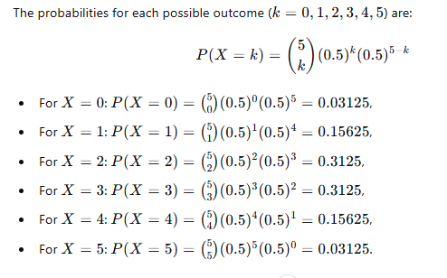
Step 1: Calculate Probabilities

Slide 8
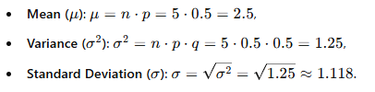
Step 2: Mean and Variance

Slide 9
Example 2: Quality Control in Manufacturing
A factory produces light bulbs, and each bulb has a 2% chance of being defective (p=0.02). If a batch contains n=100 bulbs, what is the probability of finding exactly k=3 defective bulbs?

Slide 10
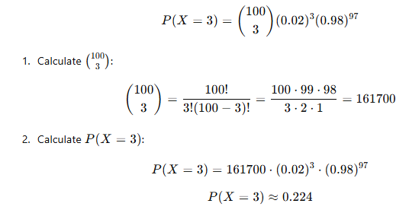
Step 1: Apply the Formula

Slide 11
Step 2: Interpret
There is approximately a 22.4% chance of finding exactly 3 defective bulbs in a batch of 100.

Slide 12
Analogy
Think of binomial distribution as tossing a basketball into a hoop multiple times:
The success is making the basket.
The failure is missing the basket.
The probability of success (p) depends on your skill level. If you take 10 shots, the binomial distribution can describe how many you are likely to make, given your shooting accuracy.

Slide 13
Key Takeaways
The binomial distribution is perfect for scenarios with "yes/no" outcomes or "success/failure" scenarios.
It helps compute probabilities for a specific number of successes in a fixed number of trials.
Understanding the mean (μ), variance (σ2), and standard deviation (σ) allows you to summarize the distribution effectively.

Slide 14
1. Binary Classification Problems
In machine learning, many problems involve classifying data into one of two categories, such as:
Spam detection: Classify emails as spam (success) or not spam (failure).
Medical diagnostics: Predict whether a patient has a disease (success) or not (failure).
Connection to Binomial Distribution
Each classification instance can be viewed as a Bernoulli trial (a single trial with success or failure outcomes).
The distribution of successes (correct classifications) over multiple trials (instances) can be modeled as a binomial distribution.

Slide 15
Example
Suppose a classifier has a 90% accuracy rate (p=0.9). If the model is tested on 10 samples (n=10), the number of correct predictions (X) follows a binomial distribution. You can calculate:
The probability of exactly 8 correct classifications.
The likelihood of at least 7 correct classifications using the cumulative distribution function (CDF).

Slide 16
3. Generative Models
Generative models like Naive Bayes use binomial or related distributions to model the likelihood of data. For example:
In Bernoulli Naive Bayes, each feature of a data point is treated as a binary outcome (e.g., word presence/absence in text classification).
The model computes the probability of a given class using the binomial framework.

